Slide 1
Beer and Breweries Case Study
Banu Pullaiahnaidu and Kenya Roy​
February 21, 2023
Notes:
Please view the video presentation at: https://youtu.be/S1Ka0JfvUtY

Slide 2
Agenda
Introduction
Review Dataset: Breweries in US by State
Address Missing Values
Review Summary Statistics
Identify Relationship of ABV and IBU
Identify Relationship of ABV and IBU in Ale and India Pale Ale (IPA) Beer Styles
Conclusion

Slide 3
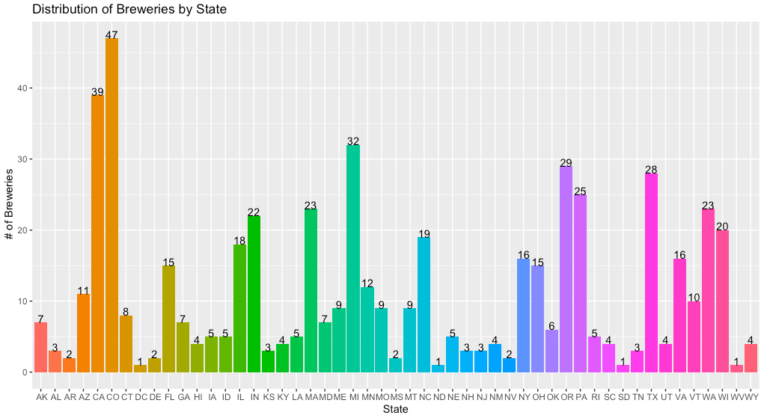
Breweries Per State

Slide 4
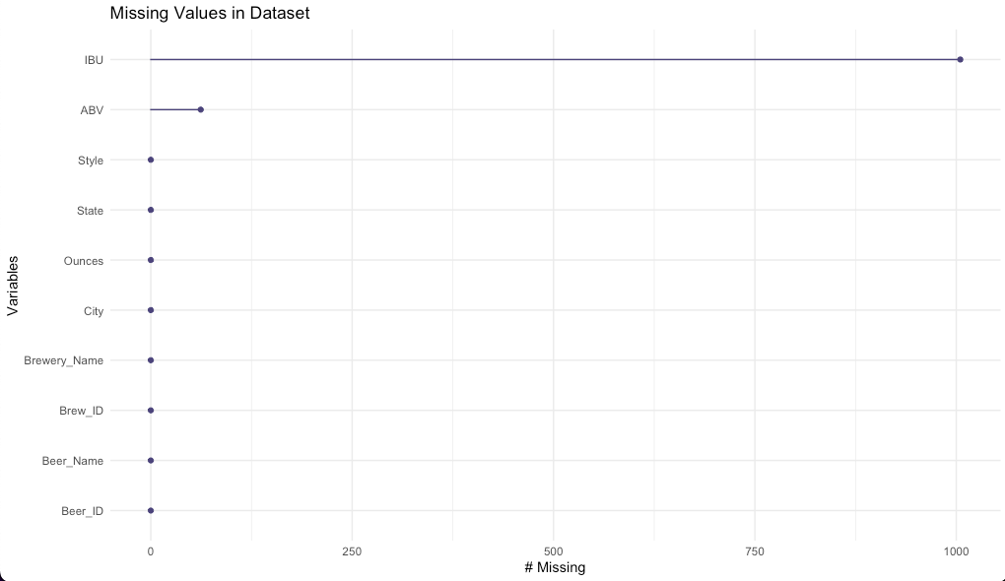
Missing Values
Conclusion
We determined that the missing IBU and ABV values were missing completely at random (MCAR) because we found that no other variable (State, Style, Ounces) impacted the probability of missingness.
Methodology: Imputation
Using our domain knowledge, we learned that every style of beer has a range of IBU and ABV values. We determined that imputation would be the best method of addressing missing values as opposed to listwise deletion.
We then used the mean IBU values and mean ABV values by style of beer to impute missing values.

Slide 5
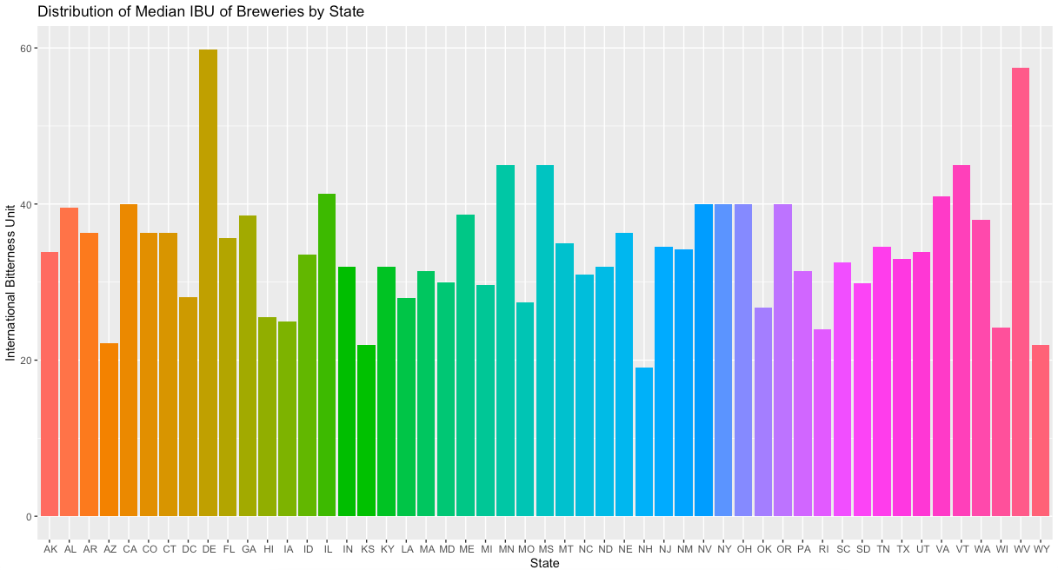
Median International Bitterness Unit by State

Slide 6
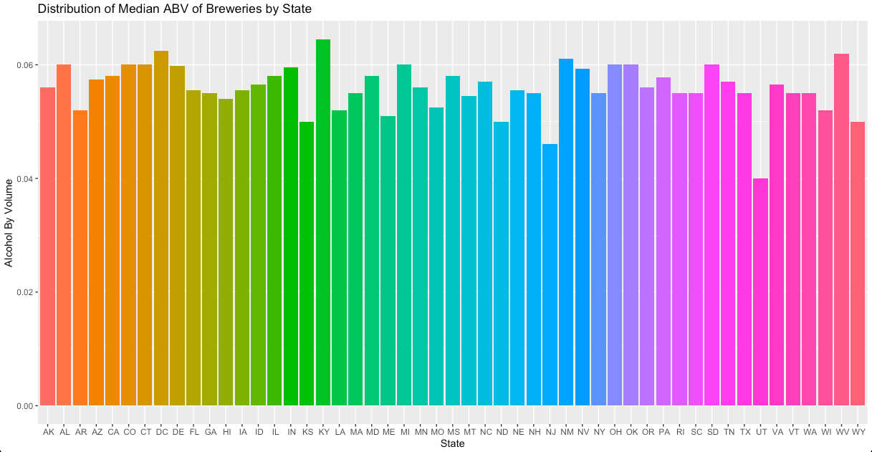
Median Alcohol Content (ABV) by State

Slide 7
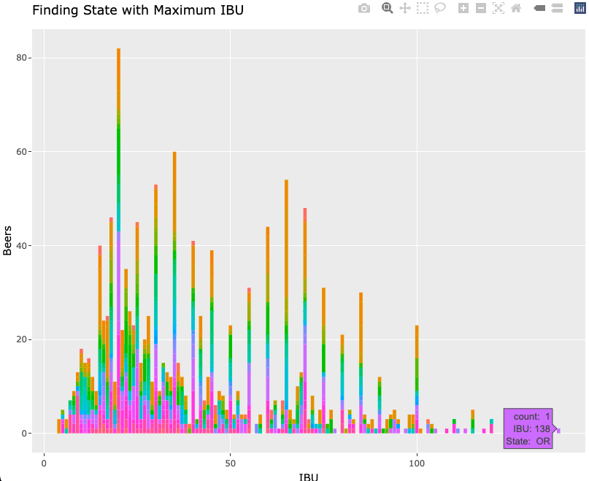
Most Bitter (IBU) Beer in the States
The state with the most bitter (IBU) beer is Oregon.​

Slide 8
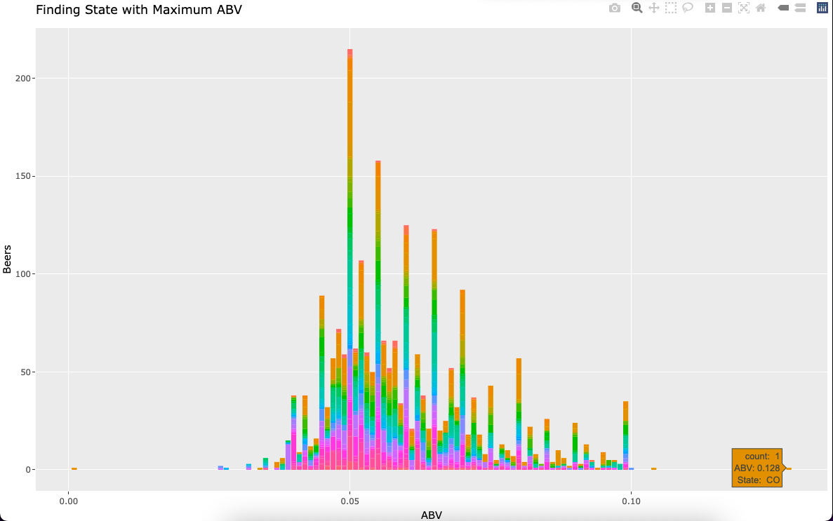
Max Alcohol Volume (ABV) Beer in the States
The state with the maximum alcoholic (ABV) beer is Colorado.​

Slide 9
Summary Statistics and Distribution of ABV
Min.​ ​ | 1st Qu. ​ | Median ​ | Mean ​ | 3rd Qu. ​ | Max. ​ | Std. Dev.​
0.02700 ​ | 0.05000​ | 0.05600 ​ | 0.05972 ​ | 0.06700 ​ | 0.12800​ | 0.01343​
Outliers: There are few outliers in the ABV data.
Skewness: ABV values have a right-skew distribution
Interquartile Range: 50th percentile of ABV values fall between 0.050 (Q1) and 0.067 (Q3).
(IQR = Q3 – Q1 = 0.017)
Range: The measure of spread is large.

Slide 10
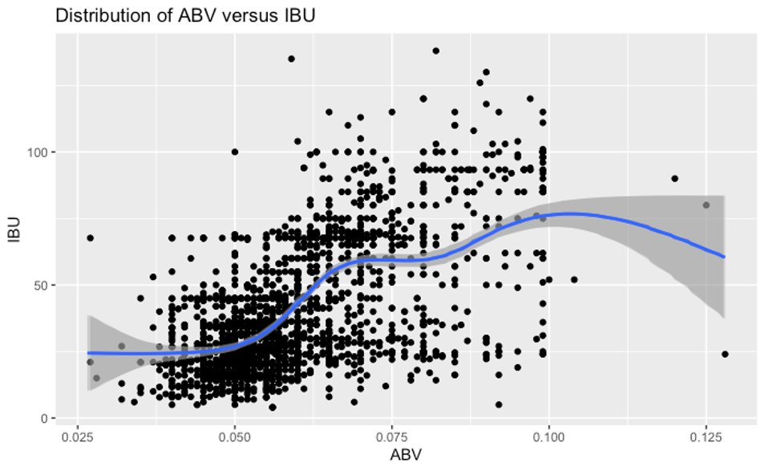
Relationship Between Bitterness and ABV

Slide 11
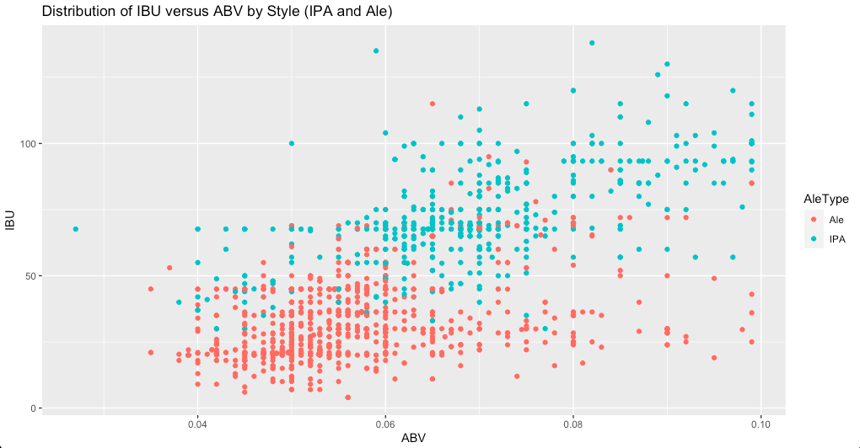
Distribution of IBU versus ABV by Style (IPA and Ale)

Slide 12
Accuracy and Classification of IPAs and Ales
Model | Accuracy | Sensitivity | Specificity
KNN | 0.8870 | 0.9199 | 0.8324
NB | 0.8500 | 0.8486 | 0.8523
Model | KNN |  | NB
 | Ale | IPA | Ale | IPA
Ale | 241 | 26 | 264 | 29
IPA | 43 | 150 | 23 | 144

Slide 13
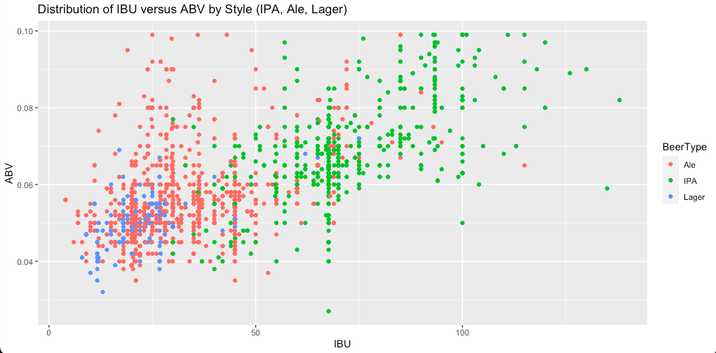
Lagers, IPAs and Ales

Slide 14
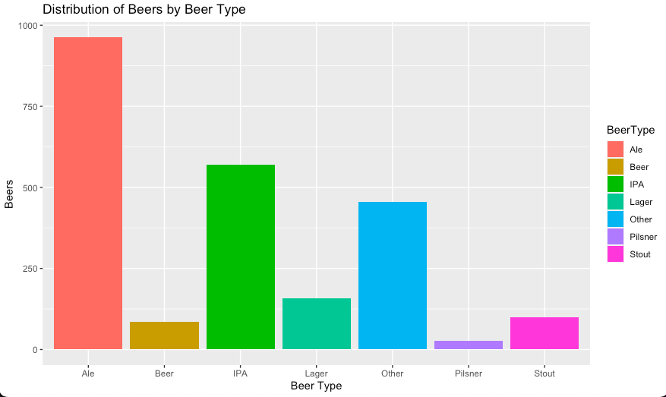
Lagers, IPAs and Ales

Slide 15
Conclusion and Discussion
Contact Kenya Roy (kroy@mail.smu.edu) and Banu Pullaiahnaidu (bpullaiahnaidu@mail.smu.edu) for more information related to this presentation.
Notes:
Close out with main findings, considerations, commitment to continue looking into the subject, if needed. (Include language about pushing the Budweiser project work forward, using data to inform big decisions related to marketing, production, sales).
Leave room for questions and ask for them if needed
3. Include contact information (number and email)

